Slide 1

WHAT UNDERLIES EXCEPTIONAL SKILL IN MUSIC?
Zach Hambrick, Michigan State University
June 16, 2017
The Neurosciences and Music VI, Boston, MA

Slide 2
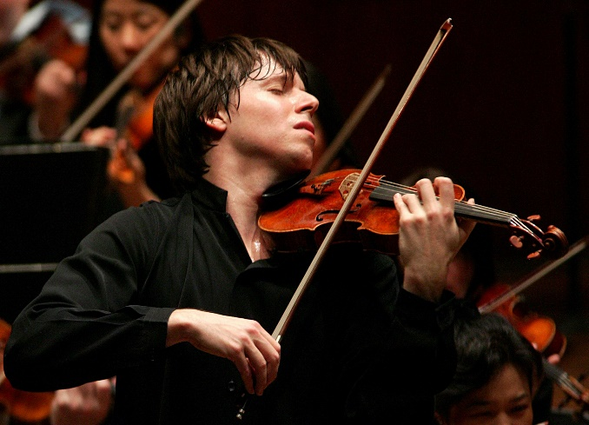
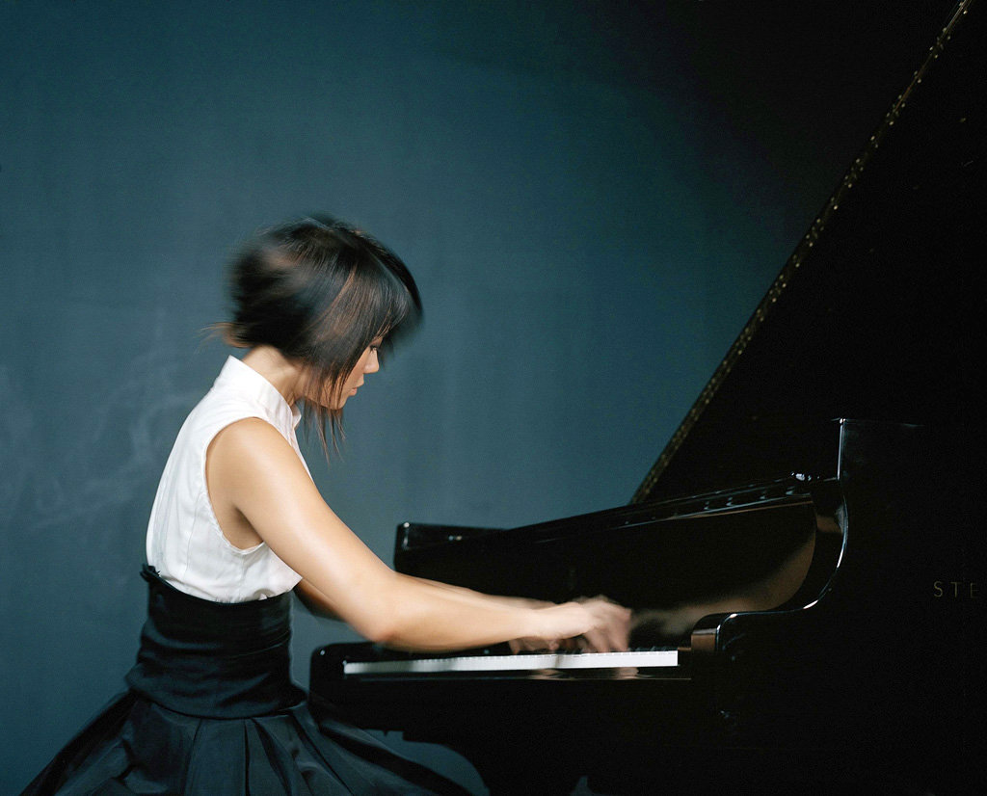
VARIABILITY IN SKILL
Joshua Bell
Yuja Wang

Slide 3
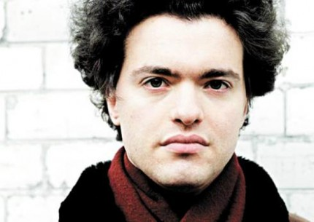
VARIABILITY IN SKILL
- Began piano studies at 6 in Moscow
- Moscow Philharmonic debut at 12
- Western European debut at 16
Evgeny Kissin
My oldest sister…studied piano at the time when I was born….I would stand all day long in my [crib] quietly. All of a sudden, on one fine day, when I was 11 months old, I sang the theme of the Bach fugue my sister was studying at the time.”
“

Slide 4

THE SCIENCE OF EXPERTISE
What factors explain this massive variability?

Slide 5
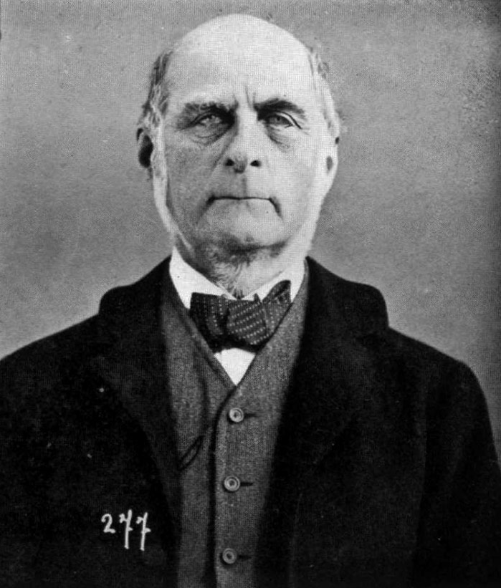
EXPERTS ARE BORN
I HAVE no patience with the hypothesis…that the sole agencies in creating differences between boy and boy, and man and man, are steady application and moral effort.”
- Francis Galton (1869)
“

Slide 6
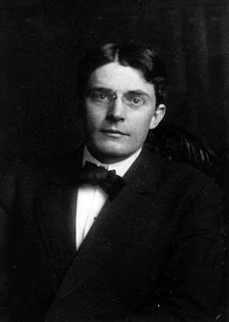
EXPERTS ARE MADE
[P]racticing more intensively than others…is probably the most reasonable explanation we have today not only for success in any line, but even for genius.”
- John Watson (1930)
“

Slide 7

DELIBERATE PRACTICE VIEW
individual differences in ultimate performance can largely be accounted for by differential amounts of past and current levels of practice.”
- Ericsson et al. (1993)
“
K. Anders Ericsson, Florida State U.

Slide 8
DELIBERATE PRACTICE VIEW
~ 10,000 hours
Results from Ericsson, Krampe, & Tesch-Römer (1993)
Figure from Ericsson (2006), Cambridge Handbook of Expertise and Expert Performance

Slide 9
DELIBERATE PRACTICE VIEW
Returning to Galton’s framework, we reject any important role for innate ability.”
- Ericsson et al. (1993)
“
K. Anders Ericsson, Florida State U.

Slide 10
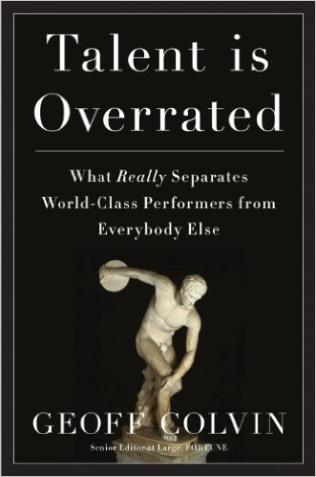
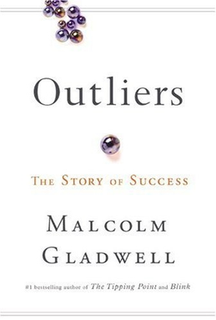
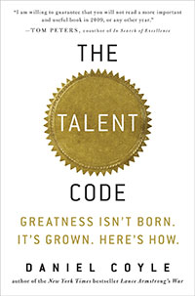
DELIBERATE PRACTICE VIEW

Slide 11

NOT EVERYONE IS CONVINCED
“
Ericsson's claims should be taken with great reluctance, because they may have highly disappointing results for parents and others who have great hopes, but no data on which to base such hopes.”
- Philip Ackerman
Philip Ackerman, Georgia Tech

Slide 12
HOW IMPORTANT IS TRAINING?
Research Question: How much of the variance in skill does deliberate practice explain? Does it largely explain the variance?

Slide 13
HOW IMPORTANT IS TRAINING?
Reliable Variance Explained
Hambrick et al. (2014, Intelligence) –
Re-analyzed results of 8 studies that included measures of music performance and of activities interpretable as deliberate practice.
Hambrick et al. (2014), Intelligence

Slide 14

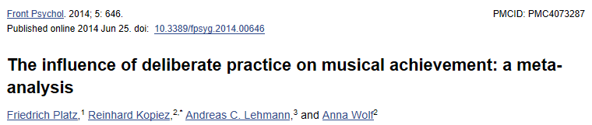
HOW IMPORTANT IS TRAINING?
Avg. corrected r = .61 (37% variance)

Slide 15
HOW IMPORTANT IS TRAINING?
Conclusion: Deliberate practice is important, but not as important as Ericsson and colleagues have argued.

Slide 16


Slide 17
One piece
of a complex
puzzle

Slide 18
What are
the other pieces?

Slide 19
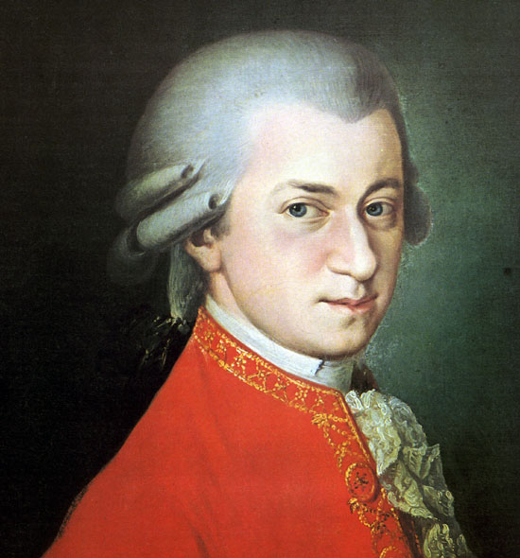
WHAT PRODIGIES CAN TELL US
Prodigy – a child who performs at a level well above same-age peers.

Slide 20
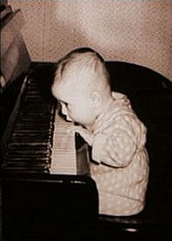
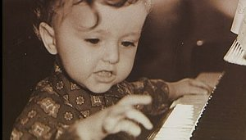
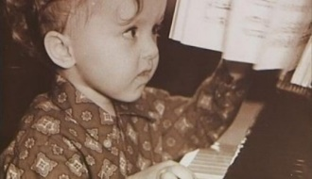
WHAT PRODIGIES CAN TELL US
Evgeny Kissin

Slide 21
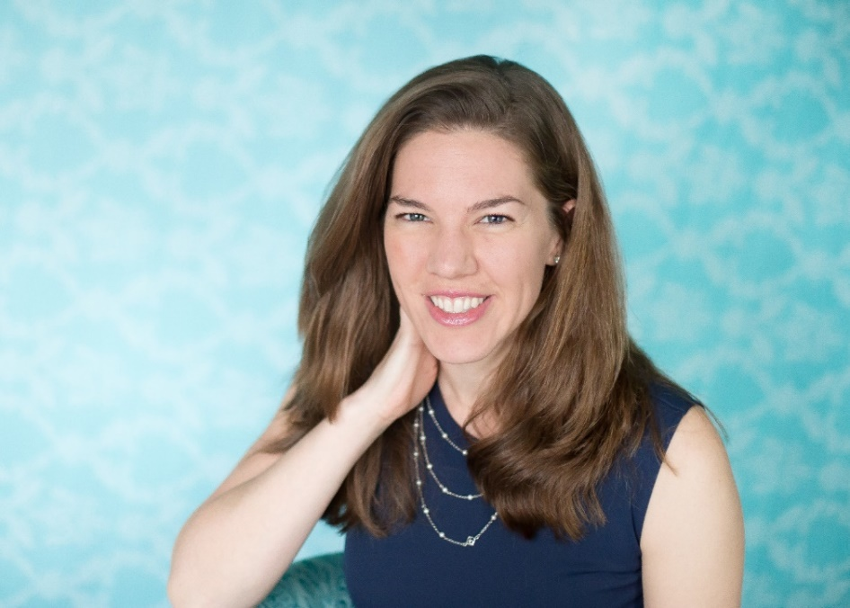
THE RUTHSATZ SAMPLE
18 prodigies
- 5 music
- 8 art
- 5 math
Joanne Ruthsatz, The Ohio State U. Mansfield

Slide 22
THE RUTHSATZ SAMPLE
Administered Stanford-Binet Intelligence Scales…
Fluid reasoning (FR)
Knowledge (KN)
Quantitative reasoning (QR)
Visual-spatial (VS)
Full-scale IQ (FIQ)
Joanne Ruthsatz, The Ohio State U. Mansfield

Slide 23
THE RUTHSATZ SAMPLE
Prodigy 4: He began to take lessons with a local instructor at three years and six months. He committed over 100 pages of music to memory with little effort within the first few months. He has played at Carnegie Hall and had a guest appearance on CBS's Early Show. He enjoys playing for benefits and with his local symphony.
From Ruthsatz & Urbach (2012)

Slide 24
THE RUTHSATZ SAMPLE
IQ Score
Stanford-Binet Subtest
Ruthsatz, Ruthsatz-Stephens, & Ruthsatz (2014), Intelligence

Slide 25
THE RUTHSATZ SAMPLE
15 of 18 > 99th percentile
IQ Score
50th to 99.9th percentile
Stanford-Binet Subtest
Ruthsatz, Ruthsatz-Stephens, & Ruthsatz (2014), Intelligence

Slide 26

WORKING MEMORY CAPACITY
Working memory capacity - ability to focus attention on task-relevant information (Engle, 2003)

Slide 27
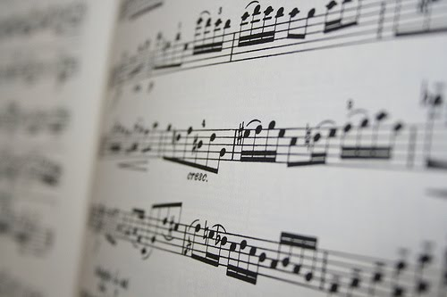
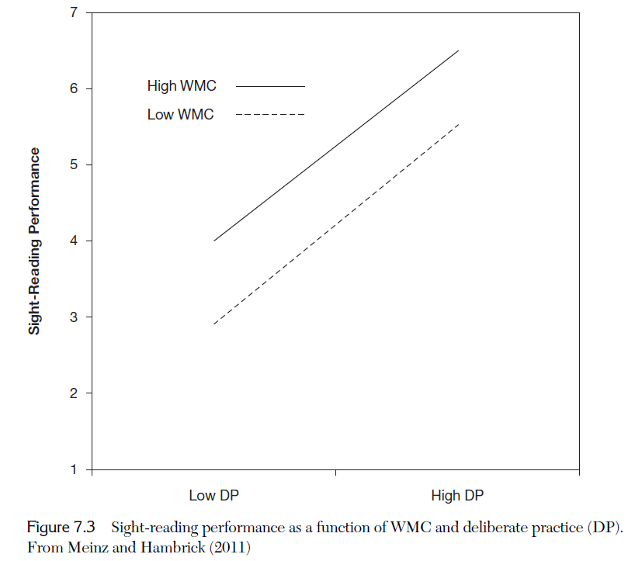
WORKING MEMORY AND MUSIC
Sight-Reading Performance
Pianists performed…
Working memory tasks
Deliberate practice survey
Sight-reading task
Low
High
Deliberate Practice

Slide 28
BEYOND BORN VS. MADE

Slide 29
BEYOND BORN VS. MADE
  We need to develop multivariate theories of expertise that take into account all potentially relevant constructs.

Slide 30
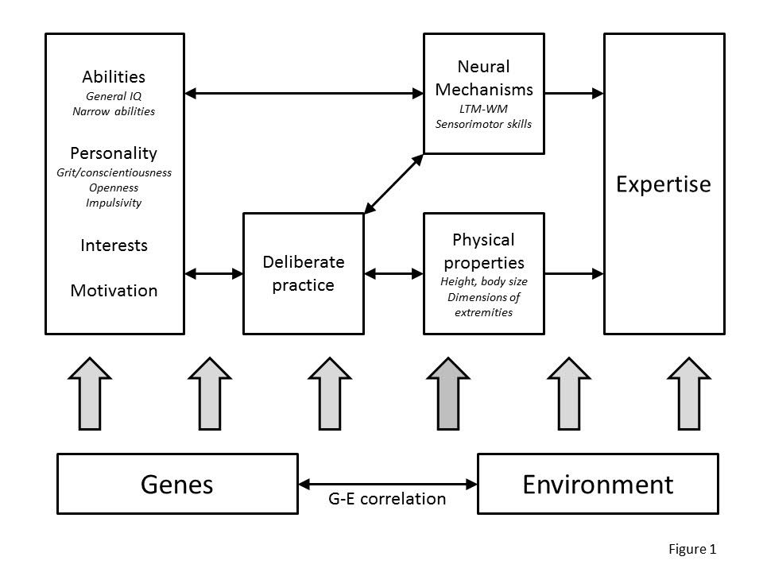
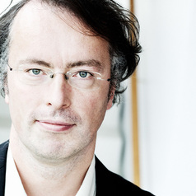
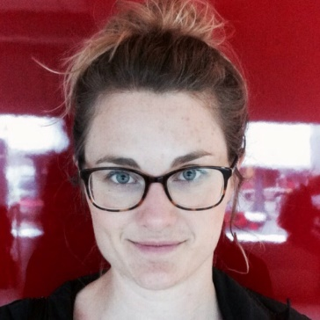
BEYOND BORN VS. MADE
Multifactorial Gene-Environment Interaction Model (MGIM)
Fredrik Ullén, Karolinska Inst.
Miriam Mosing, Karolinska Inst.
Ullén, Hambrick, & Mosing (2015), Psychological Bulletin
  We need to develop multivariate theories of expertise that take into account all potentially relevant constructs.

Slide 31
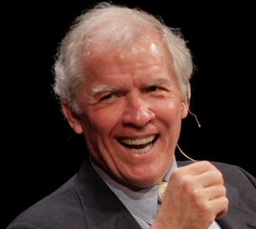
BEYOND BORN VS. MADE
it is extremely likely that environmental factors, including deliberate practice, account for far more variance in performance than does innate capacity in every salient talent domain. Even so, psychology must endeavor to identify all of the significant causal factors behind exceptional performance rather than merely rest content with whatever factor happens to account for the most variance.”
- Simonton (1999)
“
Dean Simonton, UC Davis

Slide 32


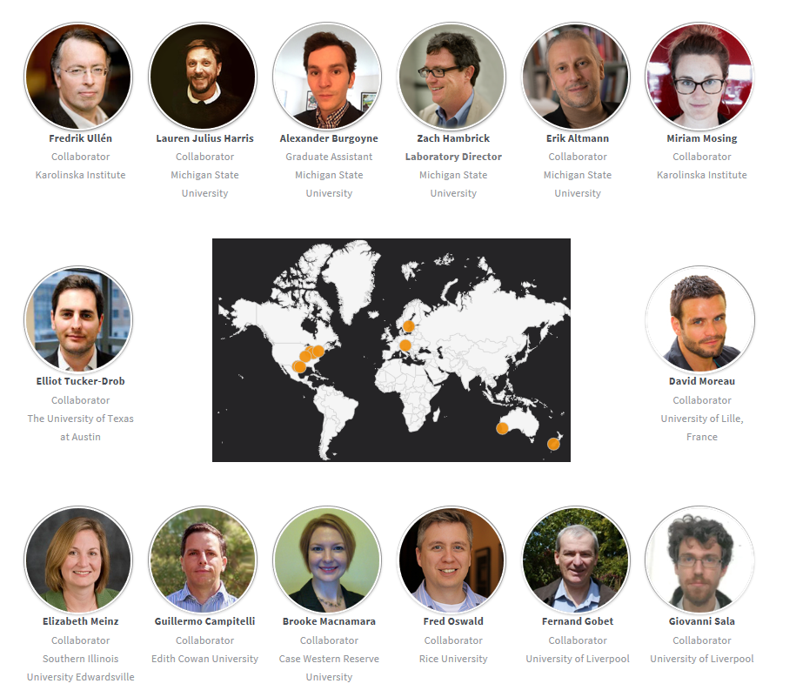
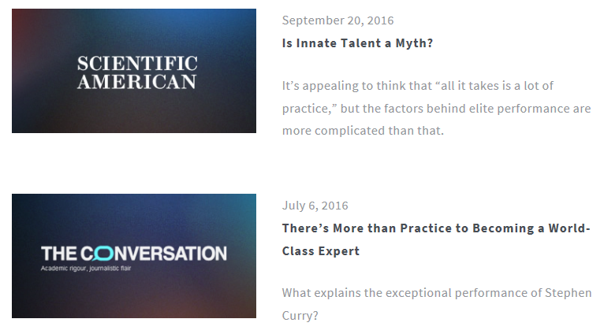
www.scienceofexpertise.com

Slide 33
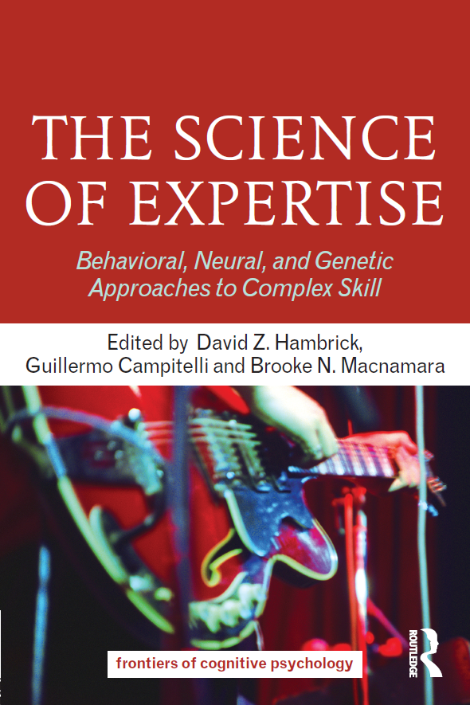

Slide 34
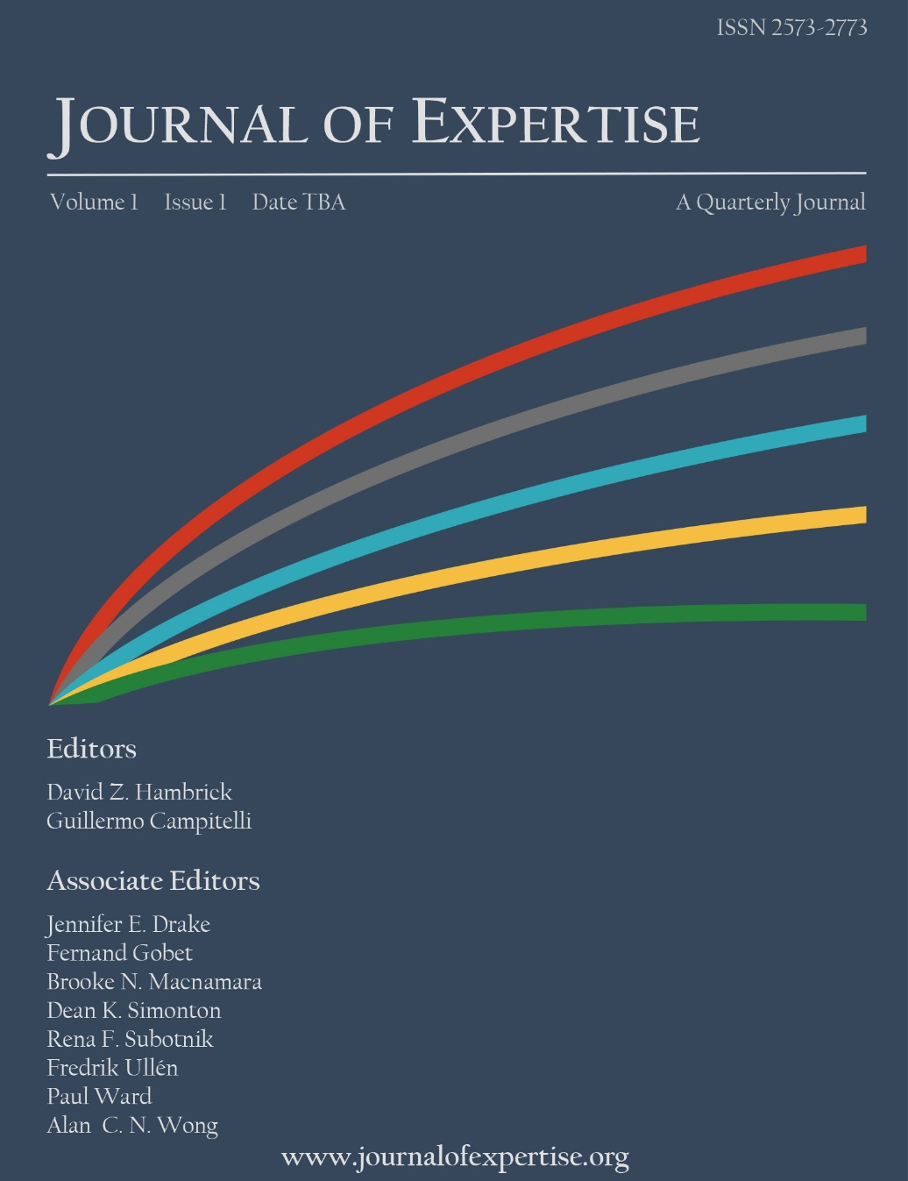
Features –
Empirical reports
Theoretical reviews
Target articles
Commentaries
Book reviews
Fully open access –
no fees for authors or readers
Accepting submissions
August 1
www.journalofexpertise.org

Slide 35
ACKNOWLEDGEMENTS
Erik Altmann Michigan State U.
Alex Burgoyne Michigan State U.
Guillermo Campitelli Edith Cowan U.
Fernand Gobet Liverpool U.
Brooke Macnamara Case Western Reserve U.
Betsy Meinz Southern Illinois U.
Miriam Mosing Karolinska Inst.
Fred Oswald Rice U.
Fredrik Ullén Karolinska Inst.

Slide 36
Thanks!

